Slide 1
User Research Summary
Prepared by the Digital Service at Veterans Affairs (DSVA)
Prepared for and presented to the VA Web Brand Consolidation Working Group
October 1, 2018

Slide 2
Outline
We gathered feedback from hundreds of Veterans about our plans for a new va.gov experience.
Study 1 – “Others” Resources Card Sort
Study 2 – Benefit Lifecycle Card Sort
Study 3 – Homepage Wireframes
Study 4 – Navigation Tree Test
Study 5 – Preview.va.gov Usability Test
Study 6 – Preview.va.gov Non-VA Vets

Slide 3
Study 6 – Preview.va.gov Non-VA Vets

Slide 4
Our goal was to assess the usability of the preview.va.gov for Non-VA Veterans
Study 6 – Preview.va.gov Non-VA Vets
Remote user research on preview.va.gov homepage, navigation, and 3 new hubs (Disability, Education, Burials)
Spoke with 8 Veterans of varying ages and races
Used the live preview.va.gov website
Asked structured interview questions to get reactions to homepage followed by specific tasks in three hubs

Slide 5
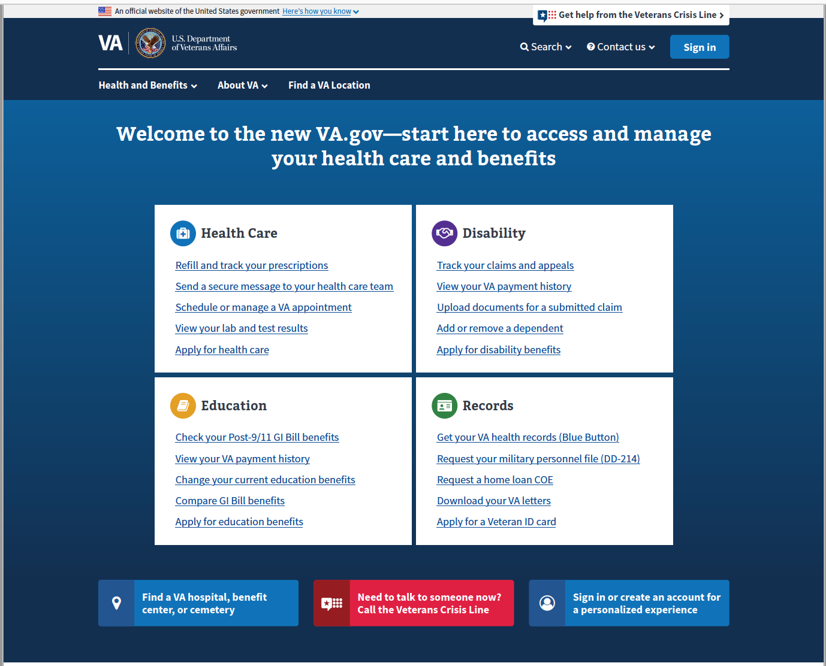
Preview.va.gov Homepage
Study 6 – Preview.va.gov Non-VA Vets
Focused on first impressions and perceived messaging on the homepage
This is the new homepage for va.gov, what are your first impressions?
What kind of message do you think this new site sends to Veterans?
What do you think you can do on this page?

Slide 6
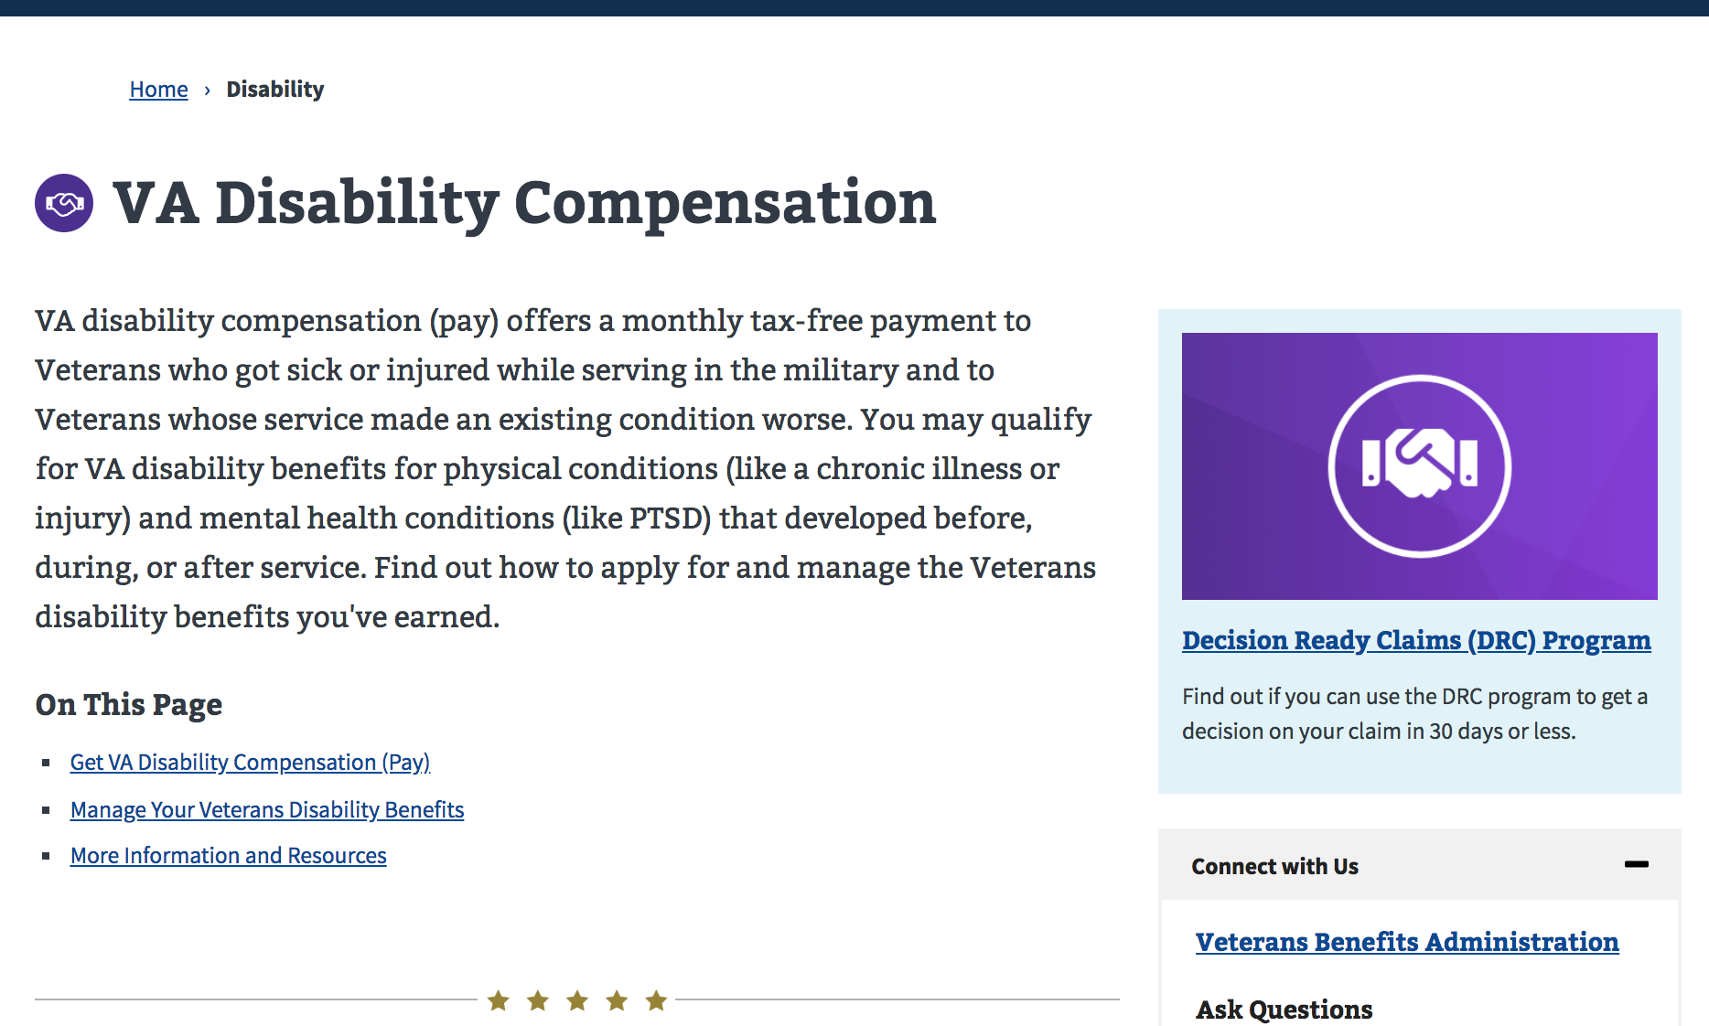
Benefit hubs tasks
Study 6 – Preview.va.gov Non-VA Vets
Gave users 6 scenarios to watch users navigate and accomplish specific tasks.
Disability Eligibility
Disability Upload Docs
Apply for Education
Transfer GI Bill Benefits
Burial Pre-need
Cemetery phone number

Slide 7
What are Veterans saying about preview.va.gov?
Study 6 – Preview.va.gov Non-VA Vets
What are your impressions of this site?
"It looks clean, search, contact us, find a location, it looks easy to use." -P1
"When it first came up on my screen, my first impressions were attractive, well laid out, I like the different colors." -P3
"There's a lot there, if I was coming in to look for something I would know where to start" -P9
"I like the way it's set up, like how it's focused on different areas, health care disability, education..." -P11

Slide 8
What are Veterans saying about preview.va.gov?
Study 6 – Preview.va.gov Non-VA Vets
What kind of message do you think this new site sends to Veterans?
"Trying to group areas to make it easier for Veterans to get to where they need to get to. Without going through 4-5 screens." -P3
"Accessible, willingness to help them find what they are looking for." -P4
"When I come on here I can clearly see that information I need is available, health care, disability, education, this is your one-stop-shop you need for Veteran related stuff." -P8
"Clean and clear, as a Veteran I have very specific questions, whether its health care, disability, education, or records. I like it, I don't have to go digging anywhere." -P12

Slide 9
What are Veterans saying about preview.va.gov?
Study 6 – Preview.va.gov Non-VA Vets
How did that compare to your past experiences with VA websites?
"Much easier, it was easy, very user friendly, intuitive about what to do. I just looked into each block, each one had a focus area. Once I found that, it was easy to follow the subheadings." -P1
"I do remember that (old VA site) was not very user friendly, this is very user friendly, it's very easy to navigate and its appealing and inviting." -P4

Slide 10
What are Veterans saying about preview.va.gov?
Study 6 – Preview.va.gov Non-VA Vets
If this website went live tomorrow, what would you want other Veterans to know?
"I would email other Veterans and tell them they really need to check out this website, it's not the website of old. They really need to check it out, they will probably find the information they are looking for fairly easily here." -P4
"It’s been re-designed and it’s easier to use. Thoroughly vetted to help allay their fears." -P9
"It’s out there and it’s easy to use. it covers everything a Veteran might need to know about, I’m excited to see this come out. so, I can see what areas I can use for myself in addition to the Tricare I have now.” -P11

Slide 11
Preview.va.gov is a hit!
Study 6 – Preview.va.gov Non-VA Vets
Feedback from non-VA veterans was overwhelmingly positive
Users appreciated the simplicity and layout of the homepage
Users generally completed the scenarios, but tasks that were not listed in the “top 4” boxes were much more difficult
VCL got good reception and emphasis from Veterans

Slide 12
Veterans called our attention to some improvements
Study 6 – Preview.va.gov Non-VA Vets
The top tasks on the homepage worked well but Veterans still tended to overlook the top navigation
Many Veterans did not scroll down the homepage, even when seeking benefits not in the “top 4” boxes
These resulted in significantly lower success rates for tasks not listed in the top tasks area (Avg. 54% vs 88% )
Users emphasized the importance of the VCL

Slide 13
Potential design solutions and discussions
Study 6 – Preview.va.gov Non-VA Vets
May need to revisit adding a View All option to the ”top 4” boxes
Modify the fold location so its apparent to the user that more options exist lower down the page
Make the top navigation stand-out more

Slide 14
What Now?
Study 6 – Preview.va.gov Non-VA Vets
We have additional user research planned for preview.va.gov prior to launch. We may need to make these design updates to raise the success rate of the less frequent tasks.

Slide 15
Thank you!
Contact Jeff Barnes with questions:
jeffrey.barnes4@va.gov

